Slide 1
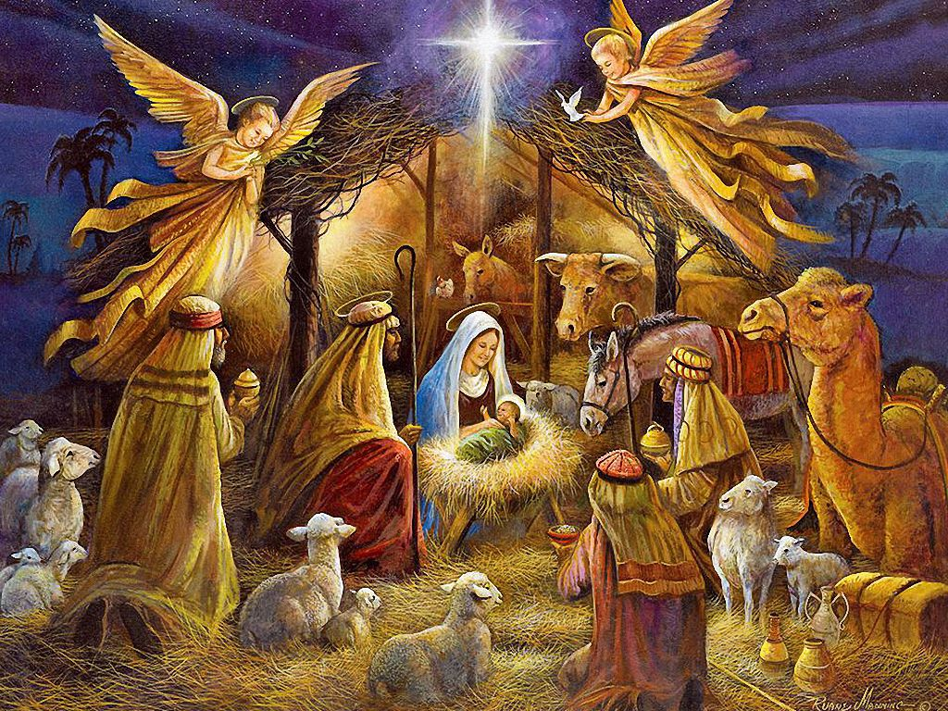
Bible Quiz 2025

Slide 2
Question No. 1*
What three titles did the angel use to describe Jesus?
YOUR OPTIONS ARE:
A. King, Prophet, Priest
B. Savior, Christ, the Lord
C. Son of David, Messiah, King
D. Prince of Peace, Mighty God, Everlasting Father

Slide 3
Correct answer – 1*
Answer:
Savior, Christ, the Lord
Luke 2:11

Slide 4
Question No. 2
Which prophet foretold the Messiah would be born in Bethlehem?
YOUR OPTIONS ARE:
A. Isaiah
B. Jeremiah
C. Micah
D. Daniel

Slide 5
Correct answer - 2
Answer:
C. Micah

Slide 6
Question No. 3*
Which Old Testament event is similar to Herod killing the children?
YOUR OPTIONS ARE:
A. David fighting Goliath
B. Jonah fleeing Nineveh
C. Pharaoh killing Hebrew babies
D. Elijah calling down fire

Slide 7
Correct answer – 3*
Answer:
C. Pharaoh killing Hebrew babies
Exodus 1:22; Matthew 2:16

Slide 8
Question No. 4
Which prophecy connects the Messiah’s birth in Bethlehem with His existence before time?
YOUR OPTIONS ARE:
A. Isaiah 9:6
B. Micah 5:2
C. Daniel 7:13
D. Psalm 110:1

Slide 9
Correct answer - 4
Answer: B. Micah 5:2
Micah 5:2

Slide 10
Question No. 5*
What detail in Matthew 2 clearly shows Jesus was no longer a newborn when the wise men arrived?
YOUR OPTIONS ARE:
A. The star stopped moving
B. Mary offered sacrifices
C. Jesus was found in a house
D. Angels appeared again

Slide 11
Correct answer – 5*
Answer:
C. Jesus was found in a house
Matthew 2:11

Slide 12
Question No. 6
Who plotted to kill
the baby Jesus?
YOUR OPTIONS ARE:
a. Barak Obama
b. King Herod
c. Bill Clinton
d. George Bush

Slide 13
Correct answer - 6
Answer b. King Herod
Herod secretly plotted to destroy the child (Matthew 2: 12-16).

Slide 14
Question No. 7
What was the name of the priest who doubted the angel about John the Baptist’s birth?

Slide 15
Correct answer - 7
Answer: Zacharias
Luke 1:18-20
“Whereby shall I know this? for I am an old man…”

Slide 16
Question No. 8*
Which Old Testament prophecy is fulfilled when Jesus’ family fled to Egypt?
YOUR OPTIONS ARE:
a. Micha
b. Hosea
c. Isaiah
d. Jeremiah

Slide 17
Correct answer – 8*
Answer: b. Hosea (Hosea 11:1)
“Out of Egypt have I called my son.” (Matthew 2:14–15)

Slide 18
Question No. 9
Who recognized Jesus as the Messiah in the temple..?
YOUR OPTIONS ARE:
a. John
b. Luke
c. Simon
d. Mathew

Slide 19
Correct answer - 9
Answer:
c. Simon

Slide 20
Question No. 10*
Which woman prophetess spoke about Jesus to all who were looking for redemption?

Slide 21
Correct answer – 10*
Answer: Anna
Luke 2:36–38: “And she spoke of him to all them that looked for redemption in Jerusalem.”

Slide 22
Question No. 11
What city did Joseph originally live in before traveling to Bethlehem?

Slide 23
Correct answer – 11
Answer: Nazareth
Luke 2:4

Slide 24
Question No. 12
What does the name “Jesus” mean?

Slide 25
Question No. 12
What does the name “Jesus” mean?

Slide 26
Question No. 13
Which Gospel records Mary visiting Elizabeth?

Slide 27
Correct answer - 13
Answer: Luke / 1:39-45

Slide 28
Question No. 14*
What sacrifice did Mary and Joseph offer at the Temple?
Your options are:
A. A lamb
B. A calf
C. Two doves or pigeons
D. Frankincense

Slide 29
Correct answer – 14*
Answer: two young dove/pigeons

Slide 30
Question No. 15
Where were the wise men warned not to return to Herod?

Slide 31
Correct answer - 15
Answer: In a dream
Matthew 2:12

Slide 32
Question No. 16*
How old was Jesus when His parents brought Him to the Temple the first time?

Slide 33
Correct answer – 16*
Answer: About 40 days old
Luke 2:22; Leviticus 12:4

Slide 34
Question No. 17
What does the name “Emmanuel” mean

Slide 35
Correct answer - 17
Answer:
God With Us

Slide 36
Question No. 18
Why did Joseph take Mary and Jesus to Egypt?

Slide 37
Correct answer - 18
Answer: To escape Herod’s plan to kill Jesus
Matthew 2:13–14

Slide 38
Question No. 19*
Which Gospel explains why Jesus was born, without describing the actual birth?

Slide 39
Correct answer – 19*
Answer: John 1:1–14

Slide 40
Question No. 20
What was the exact message the angel gave the shepherds before announcing Jesus?

Slide 41
Correct answer - 20
Answer: “Do not be afraid” Luke 2:10

